Slide 1
Energy Consumption Analysis
CAREER FAIR DATA ANALYSIS PROJECT
Submitted by
Nalina Lingasamy
DTM10

Slide 2
Problem Statement
This project will analyze energy usage and greenhouse gas (GHG) emissions of Ontario's Broader Public Sector (BPS) organizations, leveraging a comprehensive database of reported data.
This is to identify trends, assess conservation effectiveness, and pinpoint areas for improvement, informing data-driven strategies to achieve climate change mitigation goals within the BPS.

Slide 3
Technologies Used
Data Cleansing
Exploratory Data Analysis (EDA)
Visualization (Power BI)

Slide 4
Data Understanding
The Dataset spans from 2012 to 2021 and contains information about BPS organizations, including public hospitals and school boards.
Key attributes include organization details, operational information, energy consumption data, and GHG emissions.

Slide 5
Exploratory Data Analysis
Data sets were loaded from the official page of Ontario's Broader Public Sector (BPS) (Dataset).
After loading data for all the years from 2012 to 2020 to Jupyter notebook, the following steps were done.
Each excel file was converted into dataframe by using Pandas library.
Null values were checked and null value imputation was done.
Once null values were treated, all the dataframes were concatenated to a single final dataframe.
The final dataframe was then saved as a file in excel format and loaded to PowerBI for further analysis and visualizations.

Slide 6
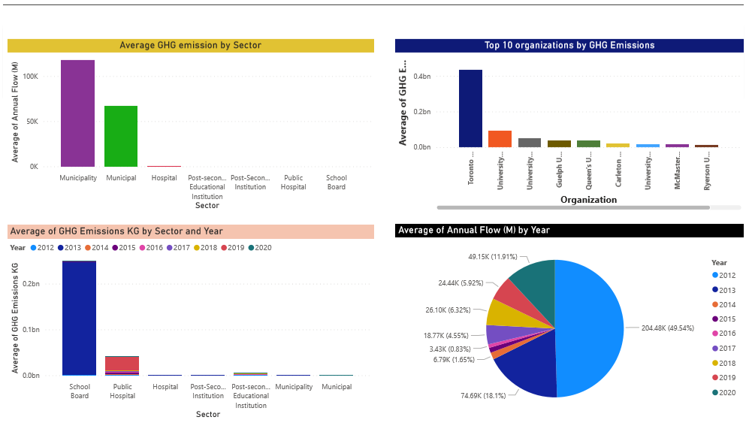
PowerBI reports

Slide 7
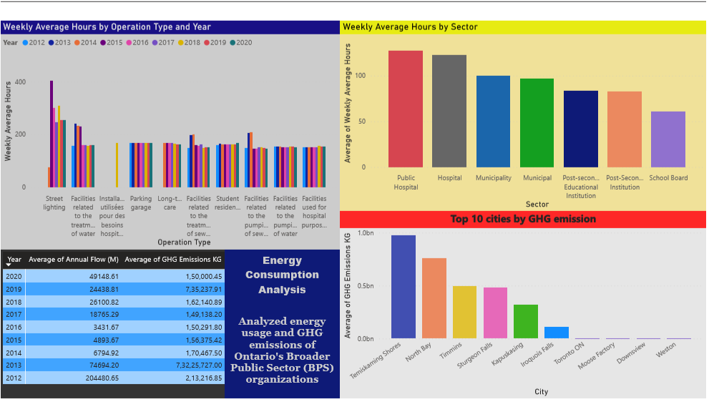
PowerBI reports

Slide 8
Conclusion
Average of Annual Flow (M) was highest for Municipality at 1,17,587.10, followed by Municipal and Hospital.﻿﻿ ﻿﻿ ﻿﻿Across all 7 Sector, Average of Annual Flow (M) ranged from 0.00 to 1,17,587.10.﻿﻿ ﻿﻿ ﻿
﻿School Board in Year 2013 made up 82.66% of Average of GHG Emissions KG.﻿﻿ ﻿﻿
﻿At 43,48,08,151.03, Toronto Mount Sinai Hospital had the highest Average of GHG Emissions KG and was 4,351.01% higher than University of Waterloo, which had the lowest Average of GHG Emissions KG at 97,68,757.68.﻿﻿ ﻿﻿ ﻿
﻿﻿ ﻿﻿Across all 10 Organization, Average of GHG Emissions KG ranged from 97,68,757.68 to 43,48,08,151.03.﻿﻿ ﻿﻿ ﻿

Slide 9
Conclusion
﻿Street lighting in Year 2015 made up 2.99% of Average of Weekly Average Hours.﻿﻿ ﻿
Public Hospital had the highest Average of Weekly Average Hours and was 108.50% higher than School Board, which had the lowest Average of Weekly Average Hours at 61.11.﻿﻿ ﻿﻿
﻿﻿﻿Across all 7 Sector, Average of Weekly Average Hours ranged from 61.11 to 127.41.﻿﻿ ﻿﻿ ﻿
At 97,32,45,745.73, Timiskaming Shores had the highest Average of GHG Emissions KG and was 53,191.52% higher than Weston, which had the lowest Average of GHG Emissions KG at 18,26,267.51.﻿﻿
﻿﻿Across all 10 City, Average of GHG Emissions KG ranged from 18,26,267.51 to 97,32,45,745.73.﻿﻿ ﻿﻿ ﻿

